Slide 1
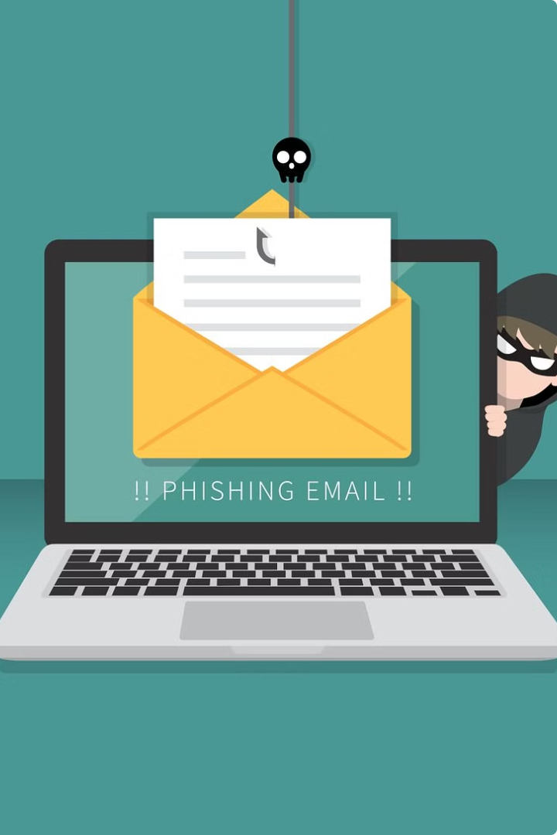
Analyzing Phishing Techniques That Bypass Spam Detection
by Dinesh Pradhan

Slide 2

Introduction to Phishing
Phishing is a deceptive technique used by cybercriminals to steal sensitive information, such as login credentials and financial data, by impersonating trustworthy entities. Phishing attacks can occur via email, SMS, social media, and other channels to lure unsuspecting victims.

Slide 3

Learning Objective
This presentation aims to equip participants with a comprehensive understanding of the evolving techniques used by cybercriminals to bypass spam detection and successfully execute phishing attacks. By exploring the latest tactics and analyzing real-world case studies, attendees will gain valuable insights to enhance their defenses against these sophisticated threats.

Slide 4
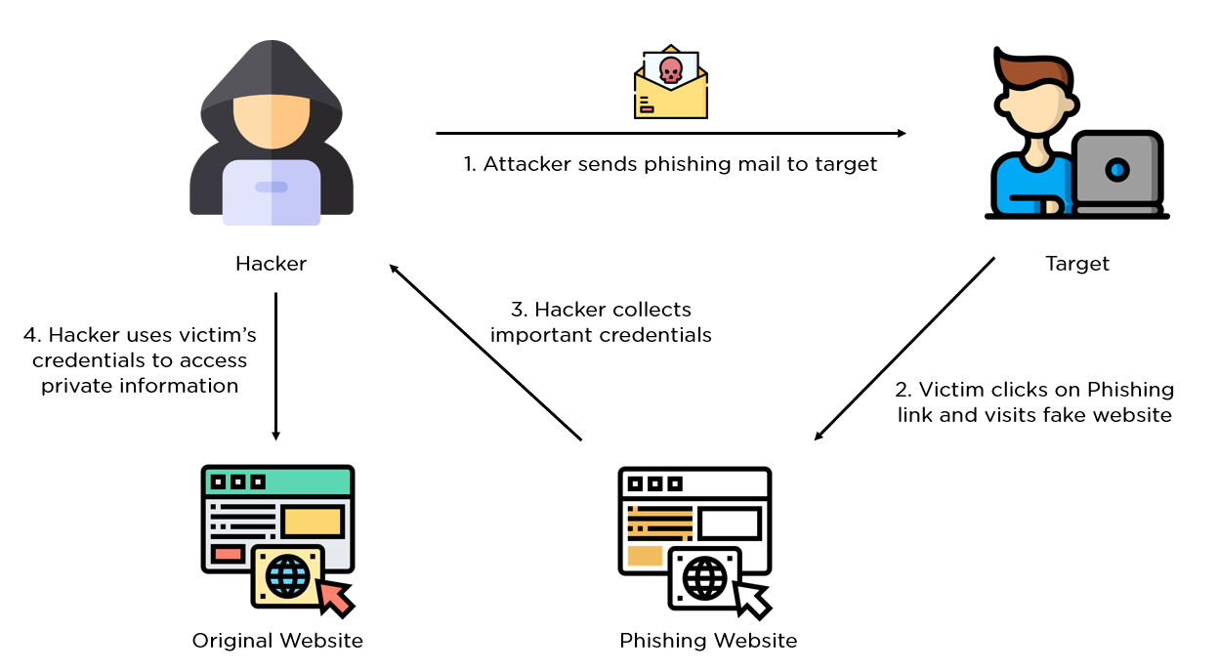
How Phishing Works
Phishing attacks leverage social engineering tactics to deceive victims into divulging sensitive information or performing actions that compromise their security. Cybercriminals create fraudulent emails, websites, or messages impersonating trusted entities to lure unsuspecting users and gain unauthorized access.

Slide 5
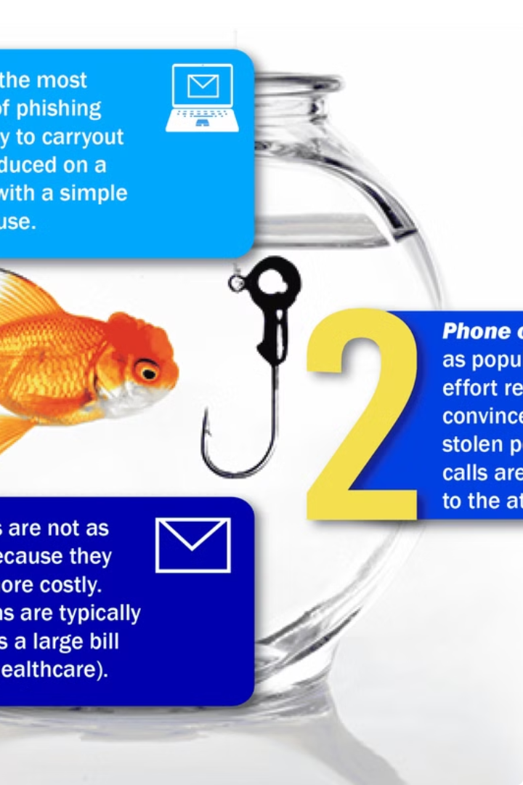
Types of Phishing Techniques

Slide 6
Types of Phishing Techniques
1
Spear Phishing
2
Email/Spam Phishing
Targeted attacks that leverage personal information to trick specific individuals into divulging sensitive data or granting access to secure systems.
Mass-produced phishing emails designed to bypass spam filters and trick a large number of recipients into falling for the scam.
3
Link Manipulation
4
Malvertising
Crafting malicious links that appear legitimate to lure victims to fake websites where they unknowingly provide their login credentials.
Embedding malicious code in online advertisements to infect users' devices when they interact with the ad content.
5
Vishing and Smishing
6
Ransomware
Voice-based (vishing) and SMS-based (smishing) phishing attacks that use social engineering tactics to extract sensitive information from victims.
Malware that encrypts a victim's files and demands a ransom payment in exchange for the decryption key, often delivered through phishing campaigns.

Slide 7

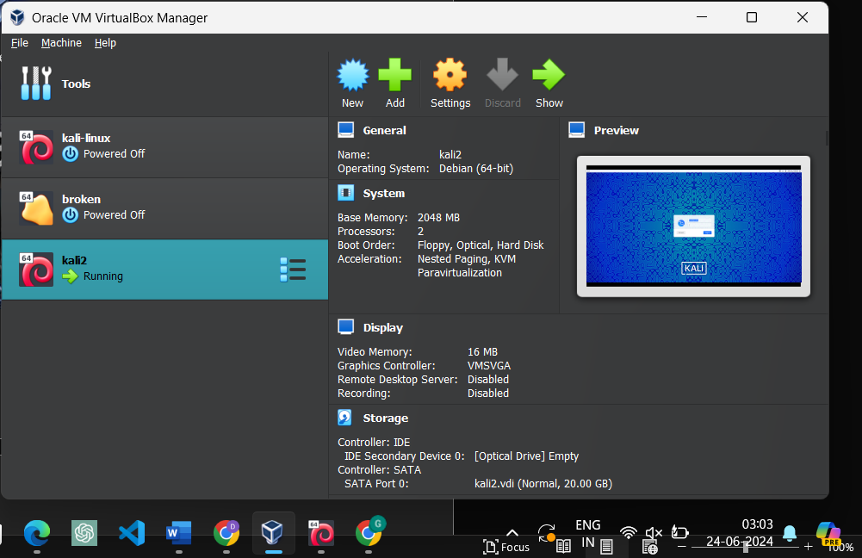
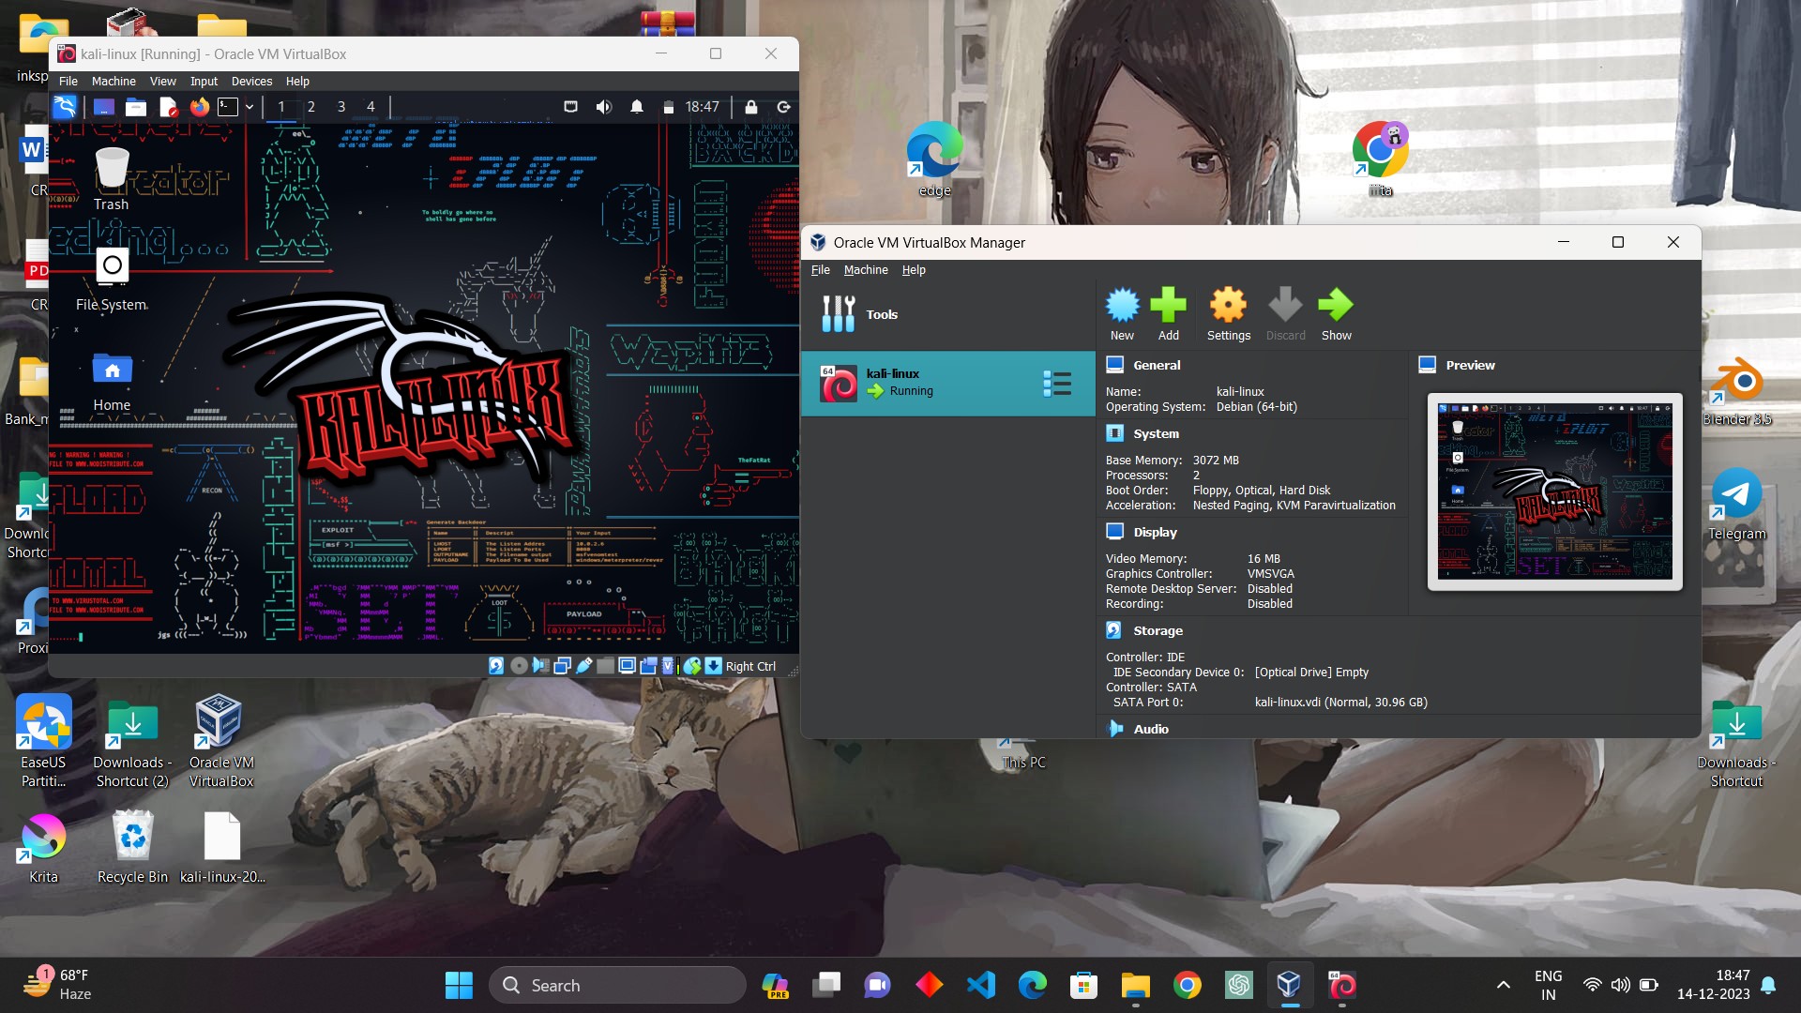
Environmental Setup
To analyze phishing techniques that bypass spam detection, we will set up a controlled environment with virtual machines, network monitoring tools, and security sandboxes. This will allow us to safely examine the technical implementation and behavior of various phishing attacks.

Slide 8
Virtualization Platform: VirtualBox
OS: Kali Linux
Phishing Campaign Tool: GoPhish, Ngrok
Phishing Tools: BlackEye
APIs: Phishtank, VirusTotal, ZeroBounce
Spam Detection Tools: SpamAssassin, Rspamd
Email Client: Mutt
Tools and Technologies Used
The tool used in this report are good and worth using if you are using for educational purpose .

Slide 9

Phishing Email Analysis and Bypassing Spam Filters

Slide 10
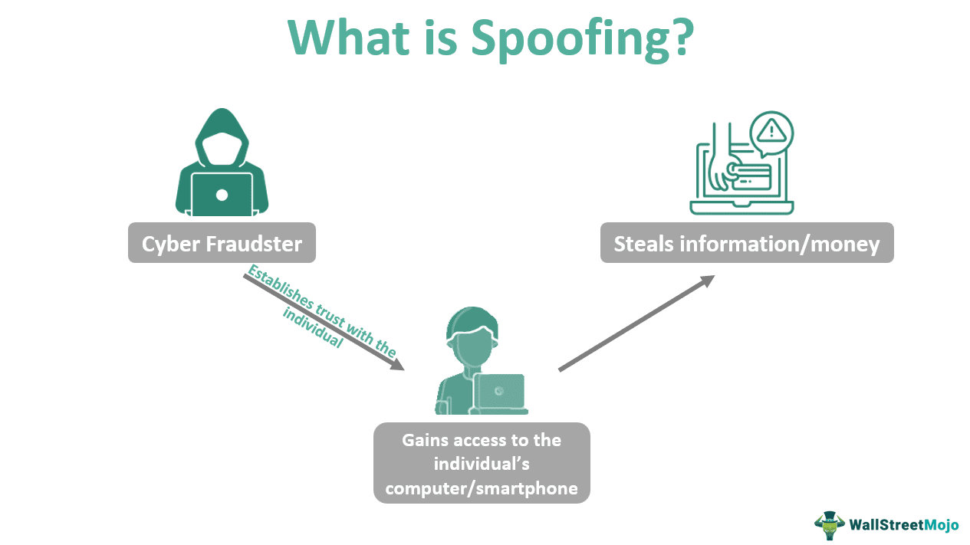
Techniques Used by Phishers
Spoofing
Obfuscation
Dynamic Content

Slide 11
Social Engineering Tactics
Emotional Manipulation
Pesonalization

Slide 12
Technical Evasion Methods
Randomized Content
Encrypted Attachments
Cross-Platform Delivery

Slide 13
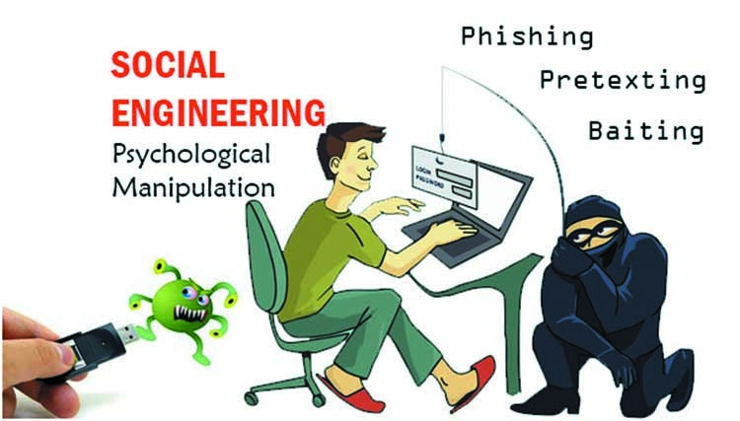
Findings
Sophisticated Techniques
Social Engineering
Dynamic and Polymorphic Attacks
Insufficient User Awareness

Slide 14
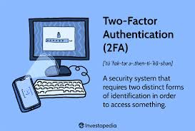
Countermeasures
Advanced Email Authentication
Enhanced Spam Detection Tools
Regular Security Updates
User Education Programs
Use 2FA

Slide 15

Conclusion
Emphasize robust spam filters is essential for combating phishing.
Stress ongoing updates and monitoring for effective protection.
Advocate for multi-layered defenses and user education.
Encourage flexibility and adoption of new technologies.

Slide 16
Thank you

